Slide 1

Attacks against Embedded Systems.

Slide 2
INTROduction
What is an embedded system?
Security? Why?
Challenges

Slide 3
Preconditions
Internet facing device
Local or remote access to the device
Direct physical access to the device
Physically proximity of the attacker

Slide 4
Vulnerabilities
Programming errors
Web based vulnerability
Weak access control or authentication
Improper use of cryptography

Slide 5
Attack methods
Control hijacking attacks
Reverse engineering
Malware
Injecting crafted packets or input
Eavesdropping
Brute-force search attacks
Normal use

Slide 6
Effects
Denial-of-Service
Code execution
Integrity violation
Information leakage
Illegitimate access
Financial loss
Degraded level of protection
Miscellaneous

Slide 7
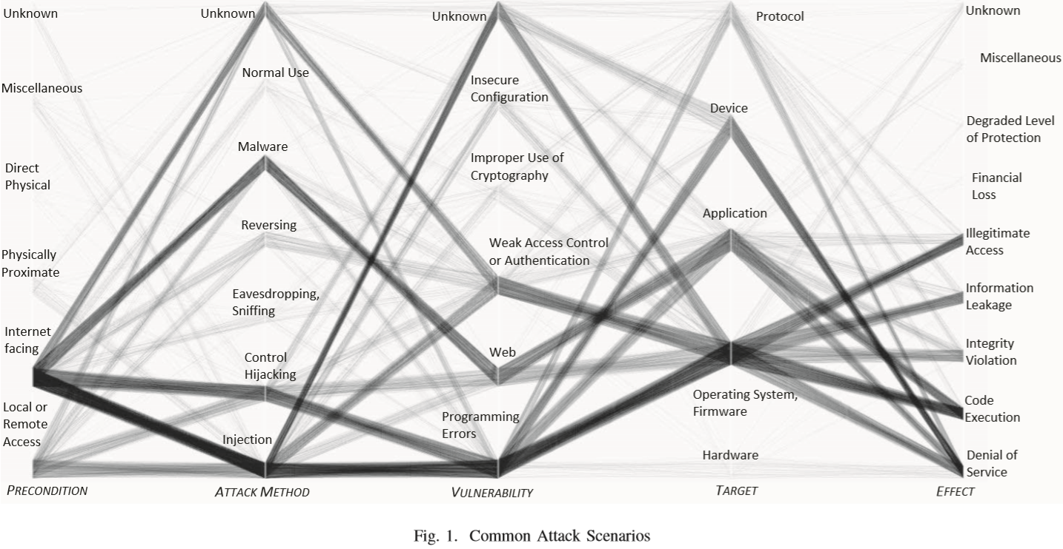
Attack patterns

Slide 8
MECHANISMS AGAINST SOFTWARE ATTACKS Objectives
Ensure privacy and integrity of sensitive code and data during every stage of software execution in an embedded system
Determine with certainty that it is safe from a security standpoint to execute a given program
Remove security loopholes in software that make the system vulnerable to such attacks

Slide 9
MECHANISMS AGAINST SOFTWARE ATTACKS Software-based solutions
Secure bootstrapping
Software authentication and validation
Operating system and application enhancement

Slide 10
References
P. Marwedel, Embedded system design: Embedded systems foundations of cyber-physical systems. Springer Science & Business Media, 2010.
R. Langner, “Stuxnet: Dissecting a cyberwarfare weapon,” Security & Privacy, IEEE, vol. 9, no. 3, pp. 49–51, 2011.
Khelladi, Lyes & Challal, Yacine & Bouabdallah, Abdelmadjid & Badache, N.. (2008). On Security Issues in Embedded Systems: Challenges and Solutions. International Journal of Information and Computer Security. 2. 10.1504/IJICS.2008.018515.
D. Papp, Z. Ma and L. Buttyan, "Embedded systems security: Threats, vulnerabilities, and attack taxonomy," 2015 13th Annual Conference on Privacy, Security and Trust (PST), Izmir, 2015, pp. 145-152.

Slide 11

Thank You
Mario.bufu@student.upt.ro

